Slide 1
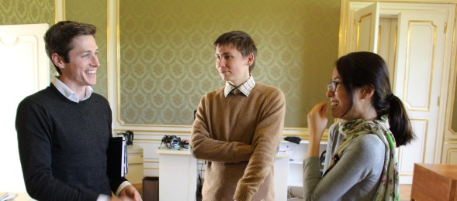
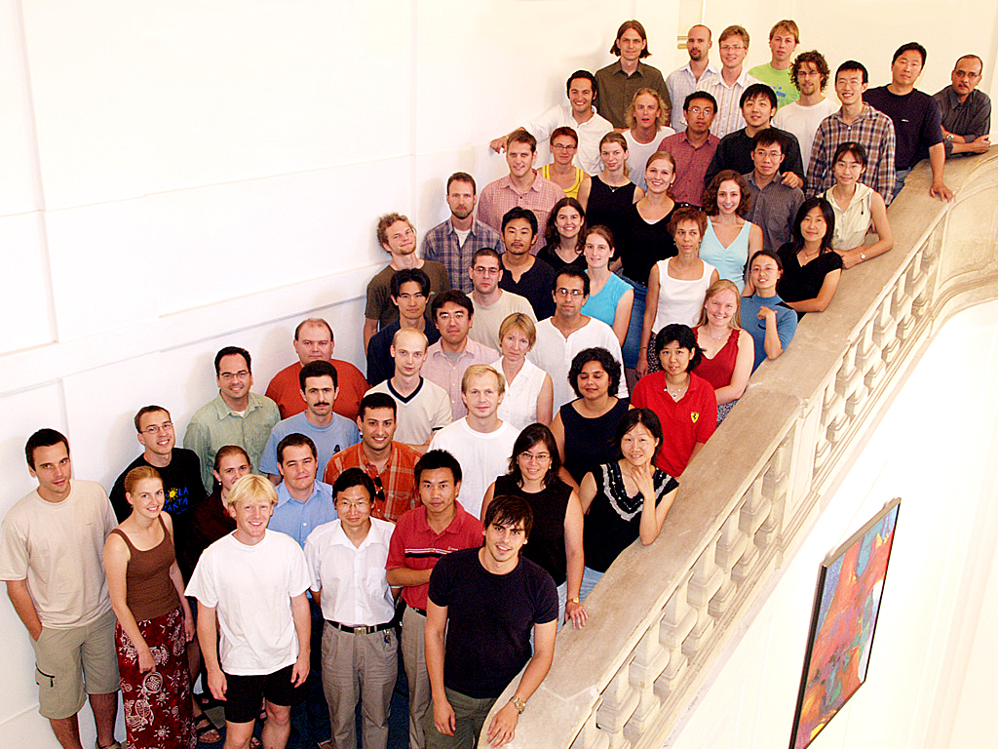
IIASA‘s Postdoctoral Program
IIASA‘s Young Scientists Summer Program (YSSP)
50 international students doing independent research, supervised by IIASA staff
1 June - 31 August, in Laxenburg, Austria
Open to advanced graduate students whose research interests (and dissertation) correspond to IIASA‘s research areas
Goal: publishable journal article
Funding available from IIASA‘s member organizations
On-line application www.iiasa.ac.at/yssp/apply
Applications for 2016 YSSP will open on 1 October and run until 11January
Up to 8 postdoctoral fellowships available
Typically 2 years duration
Applicants submit research proposal that fits with one or more IIASA focal areas
Applications are accepted continually online at www.iiasa.ac.at/postdocs
Reviews and selection of scholars occur in April.

